Slide 1
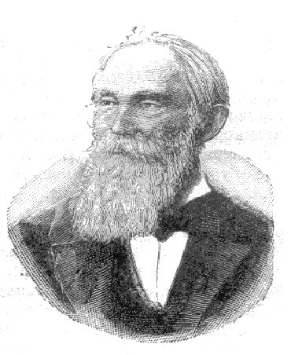
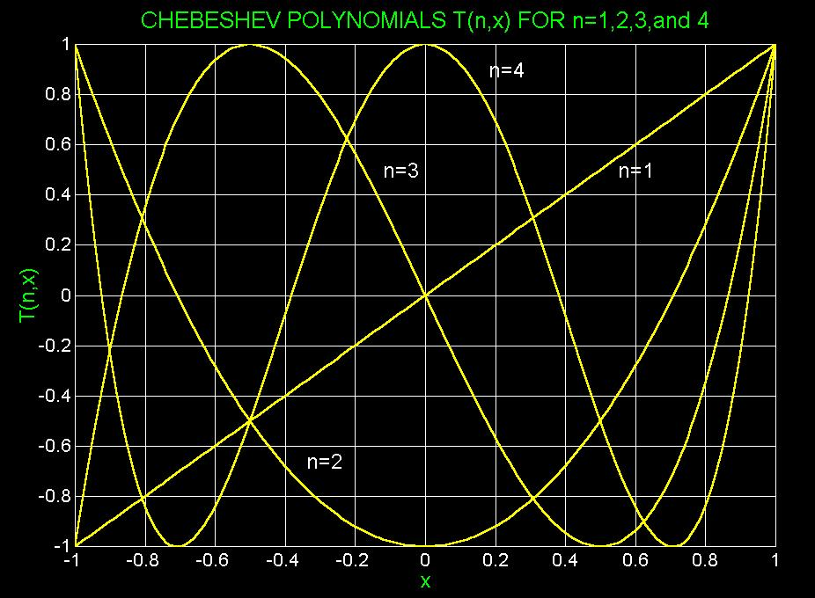
Function Approximation
Pafnuty Chebyshev, 1821-1894

Slide 2
Function Approximation
How does a computer approximate cos(x), exp(x), and other non-polynomial functions?
Efficient and accurate approximation is desired
Chebyshev polynomials
Converge faster than a Taylor series
Orthogonal polynomials
Rational functions
Ratio of two polynomials
Fourier series
Series of sine and cosine terms
Can approximate periodic or discontinuous functions

Slide 3
Chebyshev polynomials

Slide 4
Truncation Error in Taylor Series
Recall that Taylor series
If approximating a function using the first n terms
Error grows rapidly as x-value departs from x = a

Slide 5
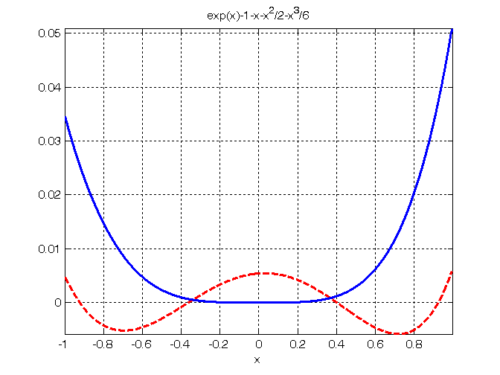
Example: truncation error of e^{x}
Error of Taylor series
Error of Chebyshev series
x
Notes:
The figure shows how the Chebyshev expansion attains a smaller maximum error by permitting the error at the origin to increase.
The error is distributed more uniformly throughout the interval

Slide 6
Chebyshev Polynomials
Recursive definition

Slide 7
Chebyshev Polynomials (cont.)

Slide 8
Chebyshev Series is More Economical
On the interval [-1, 1], approximating a function with a series of Chebyshev polynomials is better than with a Tayor series as it has a smaller maximal error
On an interval [a, b], we have to transform the function to translate the x-value into [-1, 1]

Slide 9
Example: Economizing a Power Series
Maclaurin series is the Taylor series expansion of a function about 0
Maclaurin series of e^{x}
Approximated by a Chebyshev series

Slide 10
Example (cont.)
Maclaurin series of e^{x} truncated after the 3rd degree
Chebyshev series of e^{x} truncated after the 3rd degree

Slide 11
Example (cont.)
Error of Maclaurin series grows rapidly when x-value departs from zero
Error of Maclaurin series
Error of Chebyshev series
x

Slide 12
Orthogonaliy of Chebyshev Polynomials
Two polynomials p(x), q(x) are orthogonal on an interval [a, b] if their inner product
A set of polynomials is orthogonal if each polynomial is orthogonal to each other
Chebyshev Polynomials are orthogonal on interval [-1, 1] with

Slide 13
Verify Orthogonaliy of Chebyshev Polynomials
Example: p(x) = T₀(x), q(x) = T₃(x)
Matlab code
int('(4*x^3-x)/sqrt(1-x^2)', -1 ,1)

Slide 14
Why do we care about the orthogonality?
The orthogonality can be used to express a function directly by Chebyshev polynomials where
The proof is not easy. We won’t discuss it here.

Slide 15
Least Squares Approximation using Orthogonal Polynomials
System of normal equations for a high-degree polynomial fit is ill-conditioned
Fitting data with orthogonal polynomials such as Chebyshev polynomials can reduce the condition number to about 5

Slide 16
Further reduce the truncation error?
→ Rational Function Approximation: Padé approximation

Slide 17
Rational Function Approximation
Approximating a function with a Chebyshev series has a smaller maximal error than with a Taylor series
We can further reduce the maximal error using rational function approximation
Padé approximation: n ≥ m

Slide 18
Padé Approximation
Represents a function f(x) using a Taylor series expanded at x = 0,
Coefficients are determined by setting
and equating coefficients of each order term
Notes:
Constant term
1st order term

Slide 19
Example: Padé Approximation
Find arctan(x) ≈ R₁₀(x)
Maclaurin series of arctan(x) through x¹⁰ is
Equate the coefficients of each order

Slide 20
Example: Padé Approximation (cont.)
Equating coefficients
x⁰ through x⁵
x⁶ through x¹⁰

Slide 21
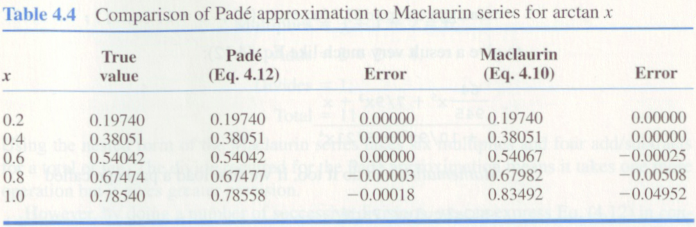
Padé Approximation vs. Maclaurin Series
Padé Approximation
Maclaurin series

Slide 22
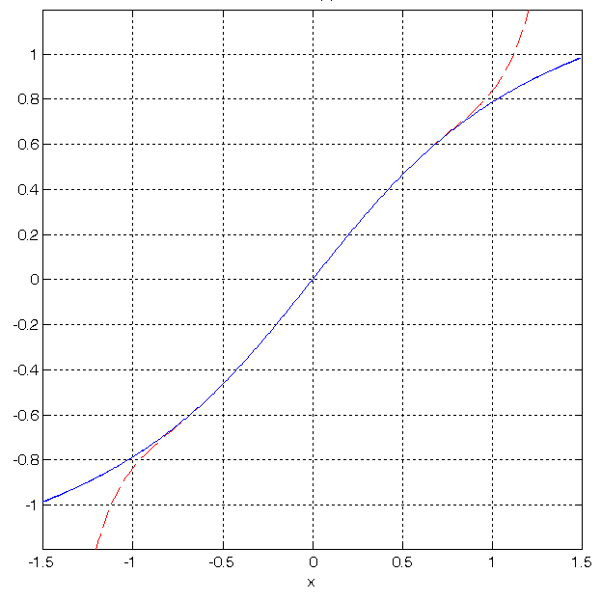
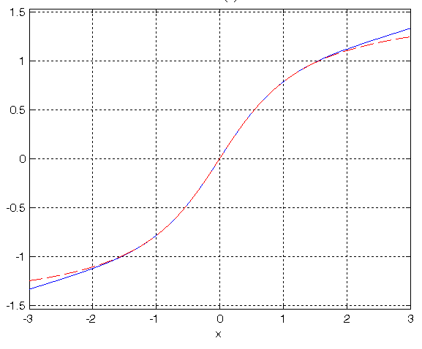
Padé Approximation vs. Maclaurin Series
Pade approximation
True value
Pade approximation
Maclaurin series

Slide 23
Chebyshev-Padé Rational Function
We can get a rational function approximation from the Chebyshev series expansion of a function as well
Example:
We first form
Then expand the numerator and set the coefficients of each degree of the T’s to zero

Slide 24
To ease our computation, we’ll derive some useful properties…
Production of two Chebyshev terms
which can be obtained by an observation that

Slide 25
Chebyshev Polynomials in Cosine Form
Equivalent form
Proof

Slide 26
Recall that
Apply the last equation to
The numerator becomes

Slide 27
Equating the Coefficients of Each Degree of T’s in Numerator

Slide 28
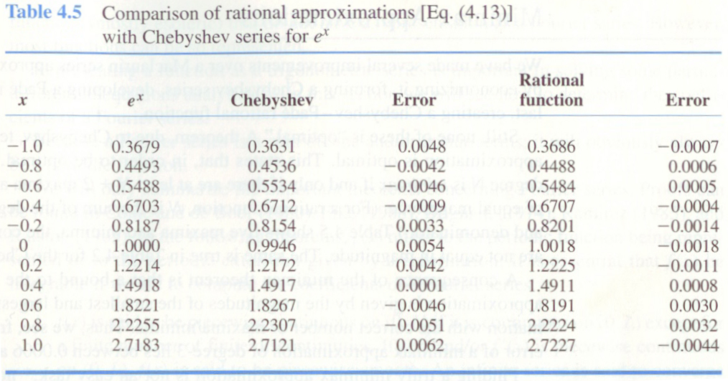
Chebyshev vs. Chebyshev-Padé Rational

Slide 29
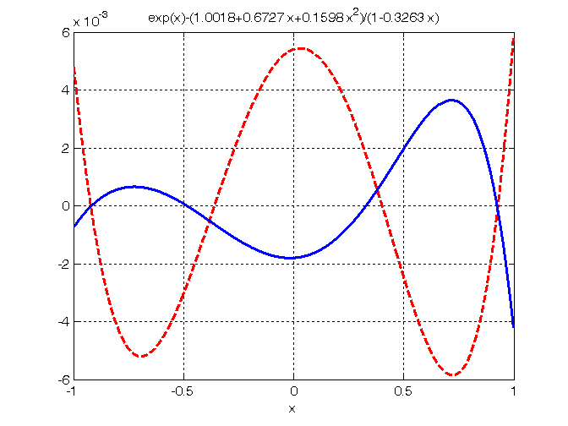
Error Plot
Chebyshev serires
Pade-Chebyshev
rational function

